Slide 1
Prod. Mgr.
Eng.
Proj. Mgr.
Release Planning Process
Effort Estimate
&
Skillset
Concept
Approval
PQC
Tollgates
Funded
Voices | Concept Initiation | Business Case | Features | KQC’s | QFD (Correlation) | Iteration Plan | Build / Test | GA
Customer Employee Chairman Market Industry Business | Vision | Objectives Commitment | (Grouped) | 30% Innovation 30% Quality 15% Oper. Efficiency 15% Revenue ($$) 10% Globalization | 6 – Strong 3 – Moderate 1 – Light 0 – None | Prod. Mgr. & Engineering Trade-offs | Design
 | Value Proposition | Competition (cannibalization) | Functional Definition |  | Release Plan | Final Iteration Plan | Dev.
 |  | Operational Burden (margin) | Priority |  | Business Iteration Plan | Scope Locked In Current Iteration | Builds
 |  | Pricing Model |  |  |  | Use Case Dev. | Test
 |  | Pricing Continuum |  |  |  | Development (Project) Plan
 |  | Pipeline (renew %) |  |  |  | *Iterates
 |  | Annual Rev $ Projection
Link
Link
Stage 1 Complete
Stage 2 Complete
Stage 3 Complete
*Note: any items colored in mustard yellow are not critical path for Stage 2 approval but must be complete prior to Iteration plan
Stage
1
2
3
Concept
Bus. Case
Project

Slide 2
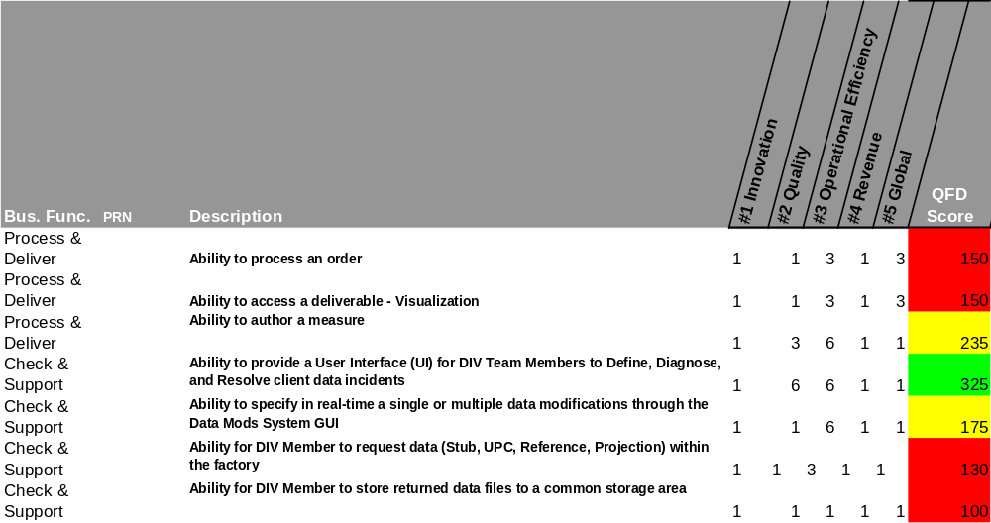
Quality For Design (QFD) – InfoScan MK
Example

Slide 3
Product Concepts
*Based on deadline, scope and budget!!
Today
Planned
Critical
Warning
On Target
 | Owner | Stage | Jun | Jul | Aug | Sep | Oct | Nov | Dec | Jan ‘06 | Feb’06 | Mar ‘06 | 2Q 06 | 3Q06 | 4Q06 | 1Q07
Product
InfoScan MK Release V1R0 (USA) | Elisa G. | 3 |  |  |  |  |  |  |  |  |  | 3/31
New Country Expansion (NCE) | Marco C. | 3 |  |  |  |  |  |  |  |  | 2/1
Builders MK | Paul W. | 3 |  |  |  |  |  |  | 12/1
Consumer MK | Paul W. | 2
InfoScan MK V2R0 (Europe) | Marco C. | 2
New Solutions
Volume Decomposition | TBD | 1
Same store sales reporting | Deb P. | 1
Store Clustering | Stuart R. | 1
Trendspotter | Stuart R. | 1
Example
Stage
1
2
3
Concept
Bus. Case
Project

